Slide 1



Git-Github/GitLab
Prepared by Anil

Slide 2
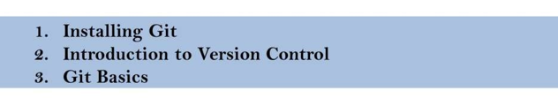
AGENDA

Slide 3
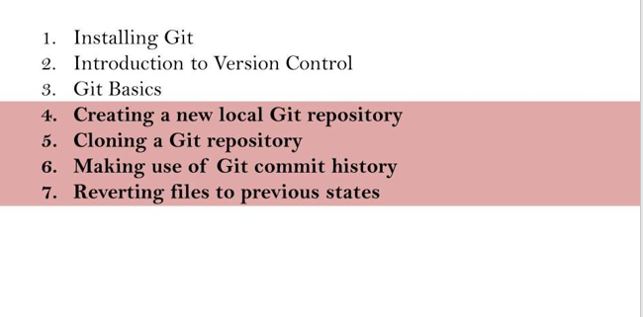
AGENDA

Slide 4
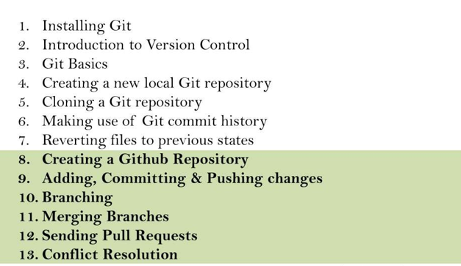
AGENDA

Slide 5
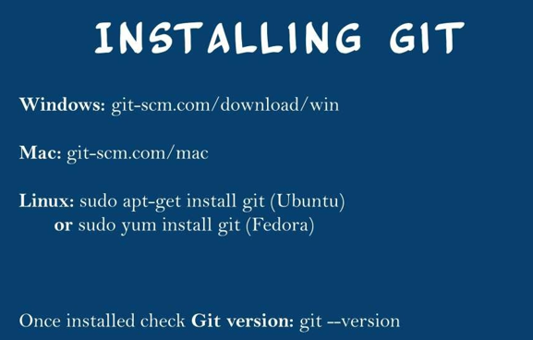

Slide 6
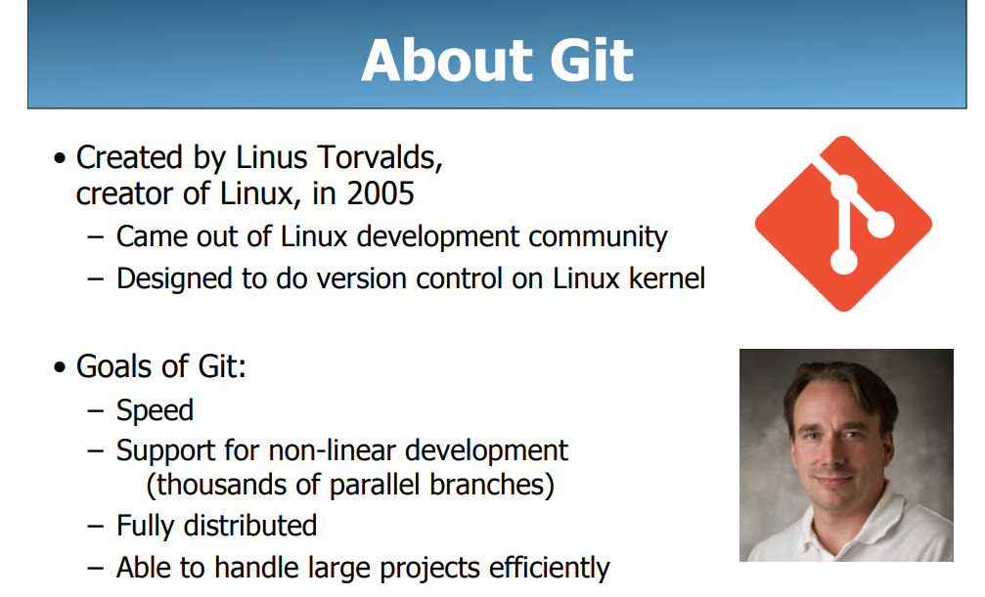

Slide 7
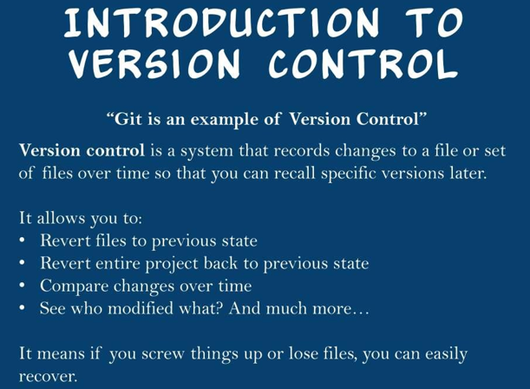

Slide 8
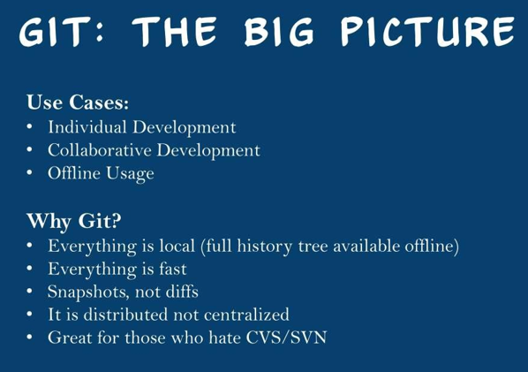

Slide 9

Getting Started
A basic workflow
(Possible init or clone) Init a repo
Edit files
Stage the changes
Review your changes
Commit the changes

Slide 10
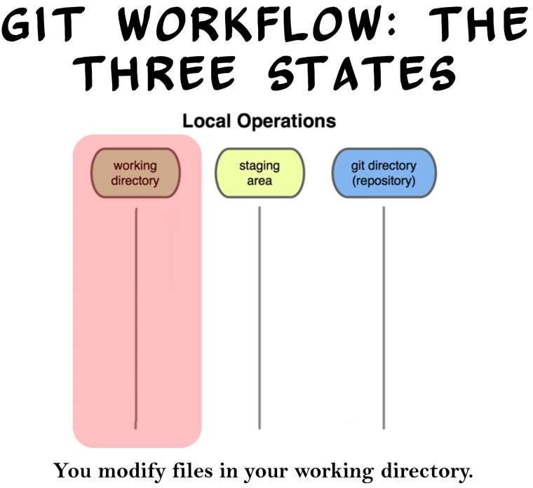

Slide 11
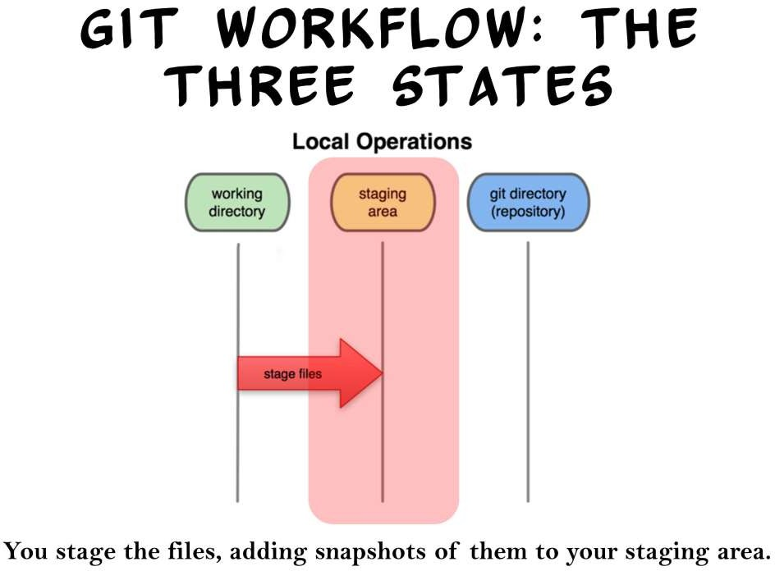

Slide 12
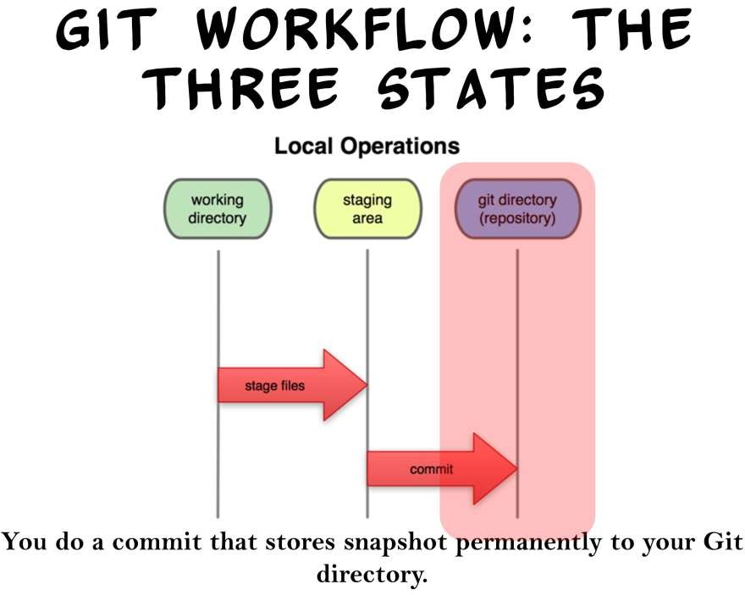

Slide 13
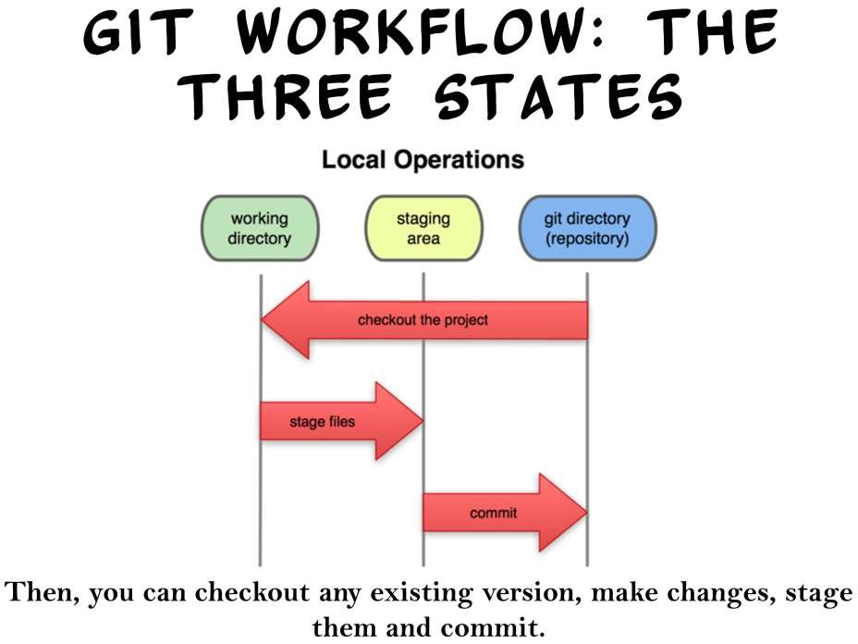

Slide 14
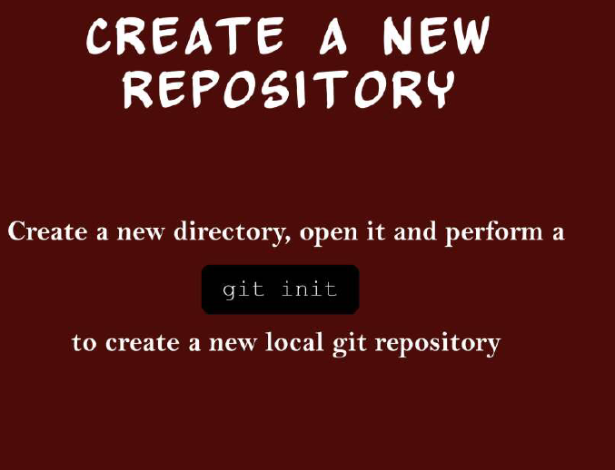

Slide 15
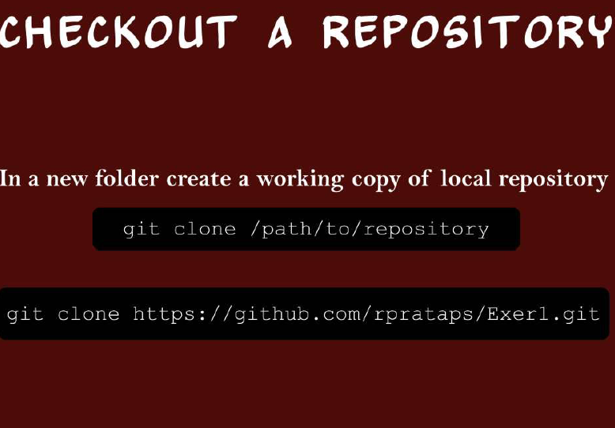

Slide 16
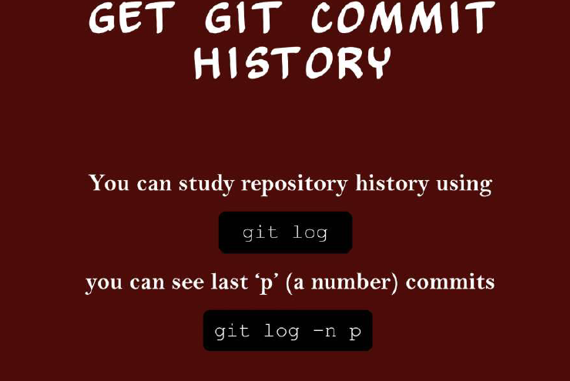

Slide 17
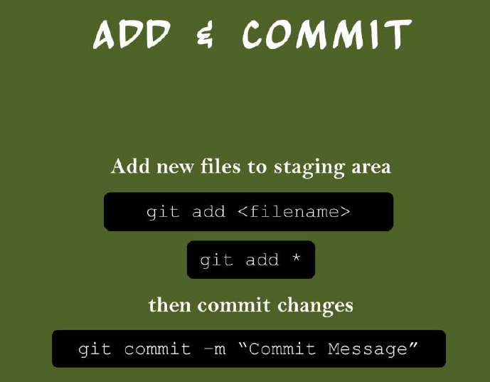

Slide 18
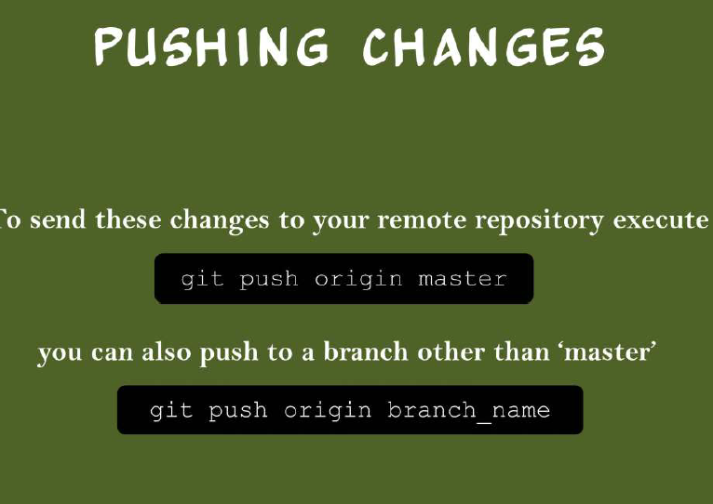

Slide 19
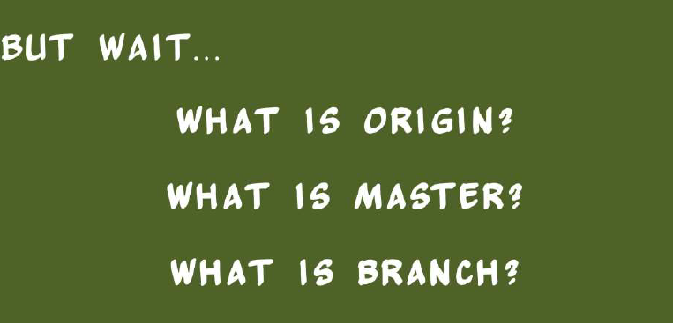

Slide 20
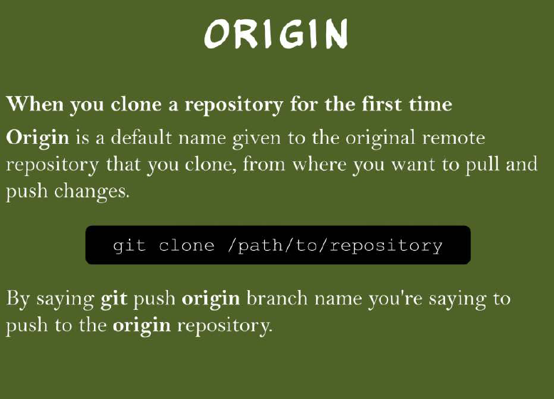

Slide 21
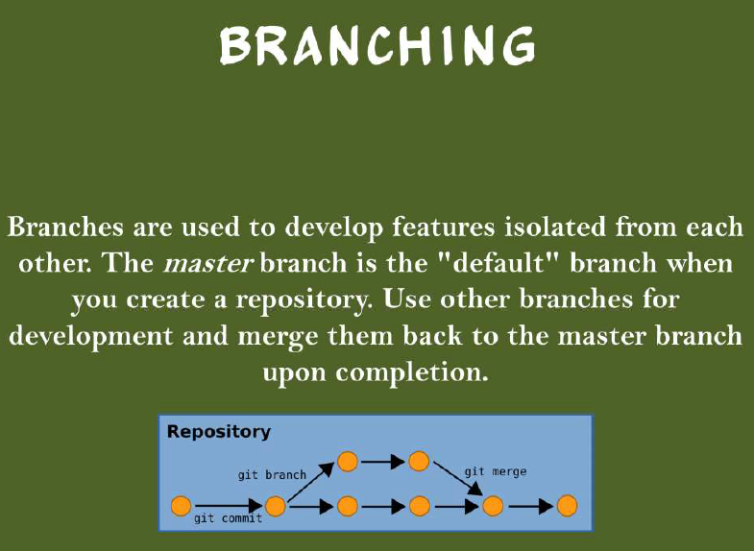

Slide 22
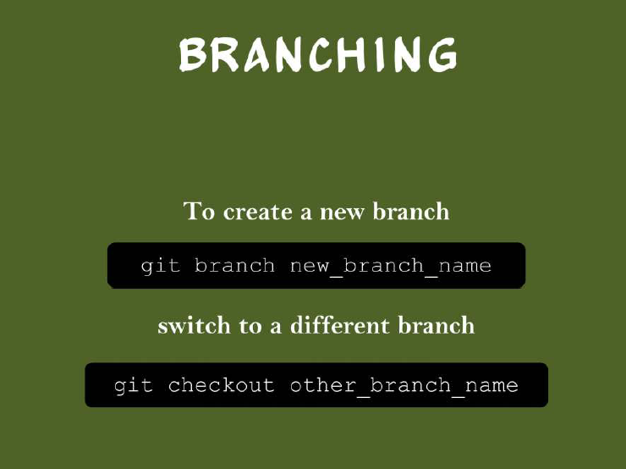

Slide 23
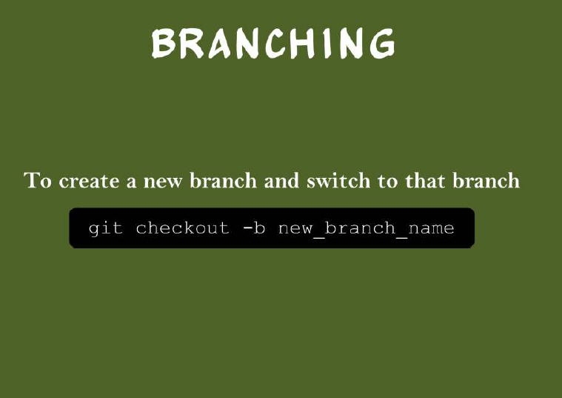

Slide 24
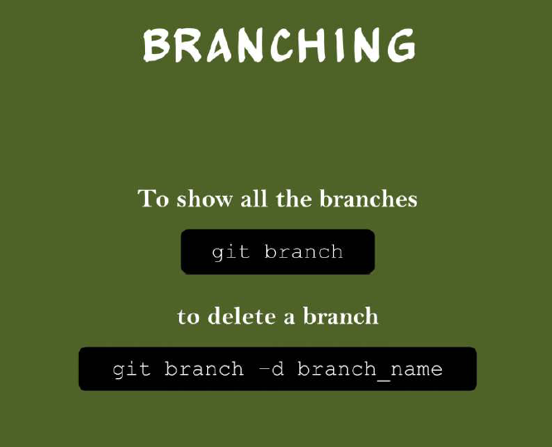

Slide 25
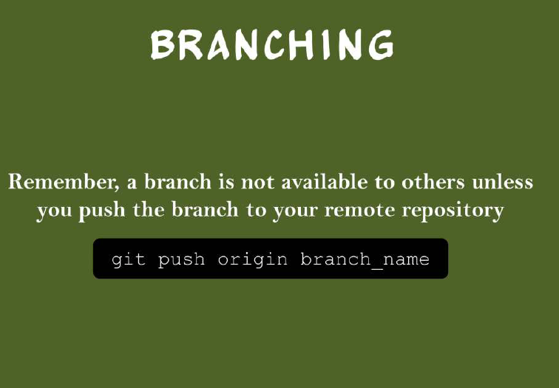

Slide 26
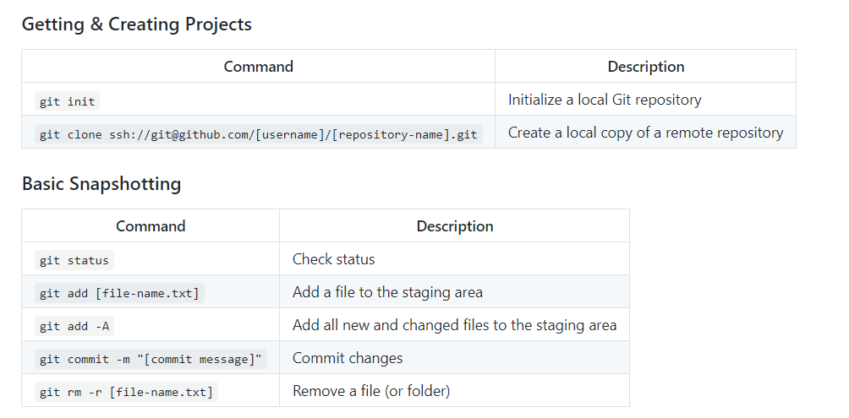

Slide 27
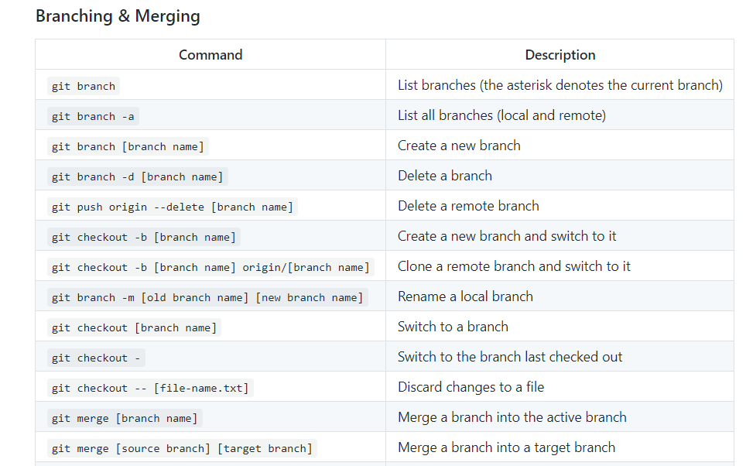

Slide 28
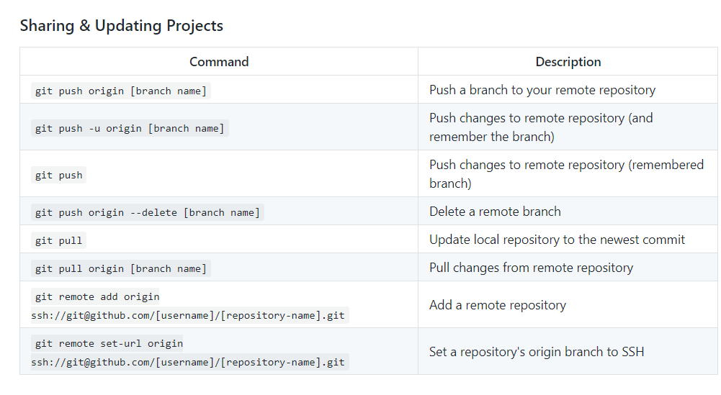

Slide 29
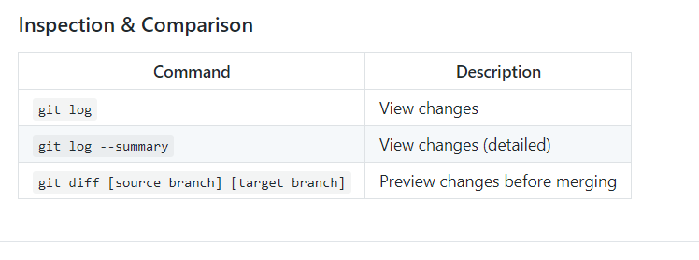

Slide 30
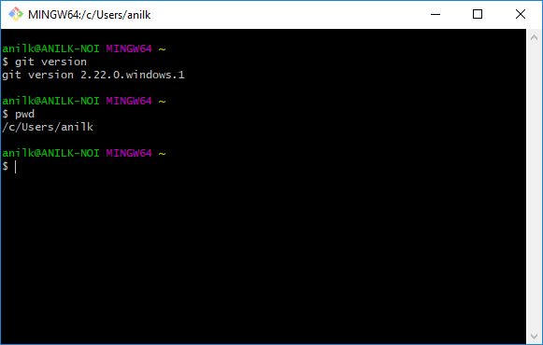
$ git version

Slide 31
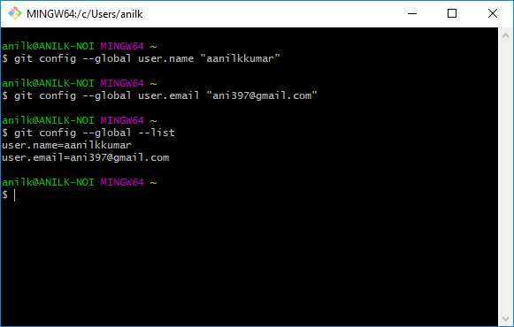
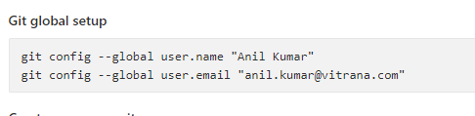
First Time Git Setup

Slide 32
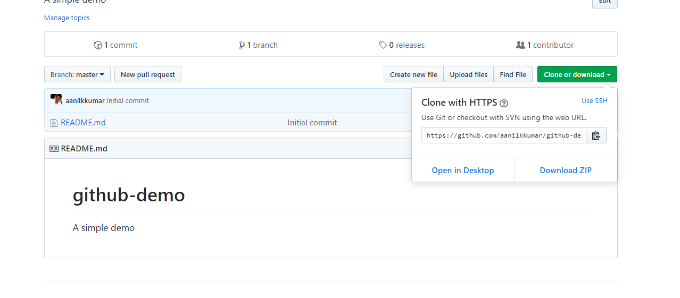
Create a project and copy the url.

Slide 33
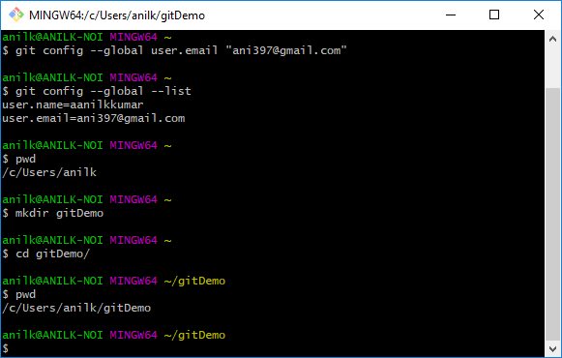
Making a directory

Slide 34
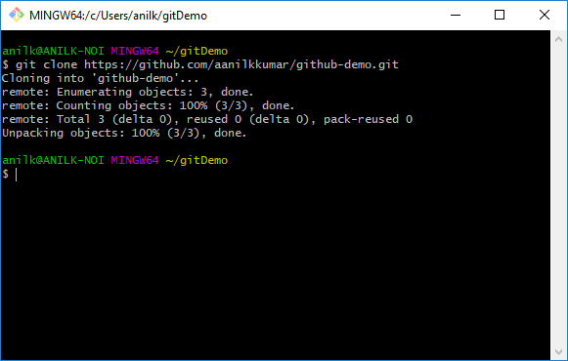
$git clone

Slide 35
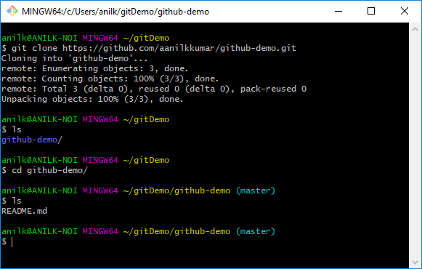
Now move to cloned directory, and type ls, we will see readme file.

Slide 36
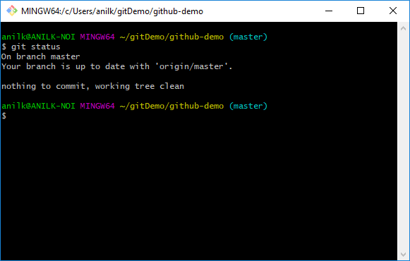
$git status
If we check the status, it will show that we are in master branch.
Master branch is the default branch by convention in git repository.
It also says that it is up to date origin/master and working directory is clean.
Working directory is the directory where we keep all files and git monitors for any change in the directory.

Slide 37
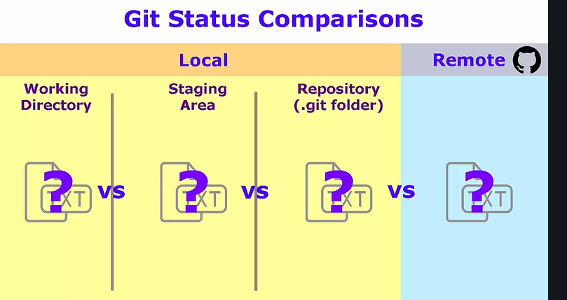

Slide 38
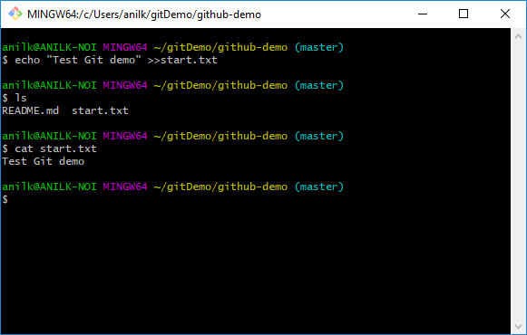
Let’s add a file

Slide 39
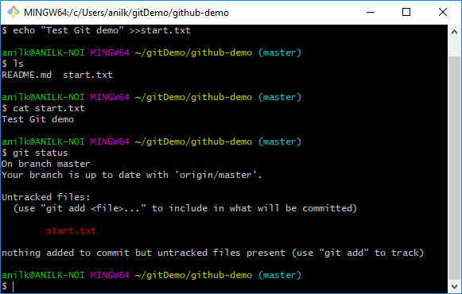
Check the status, we will see an untracked file.

Slide 40
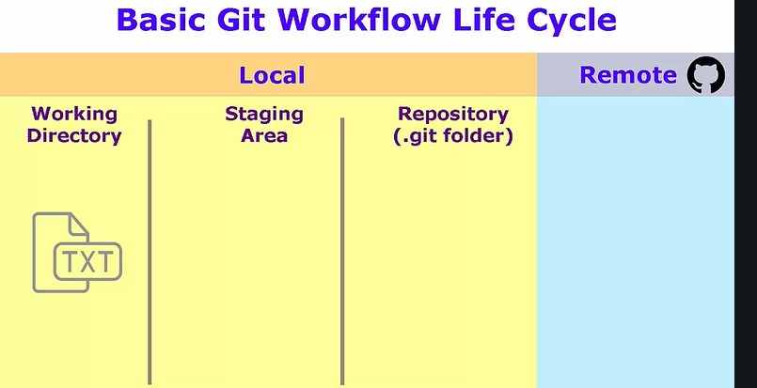
Now our file is in working directory.

Slide 41
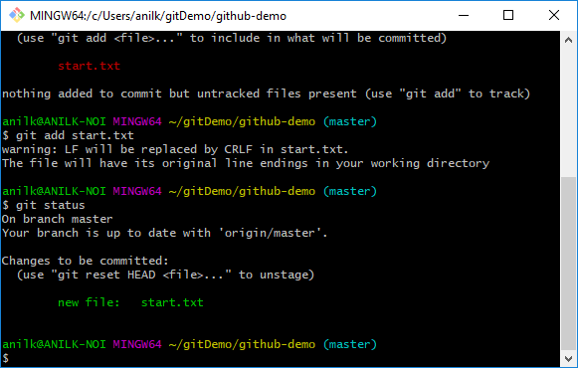
$git add filename.txt

Slide 42
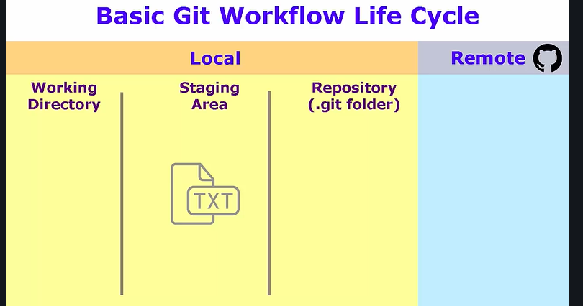
Now our file is in staging area

Slide 43
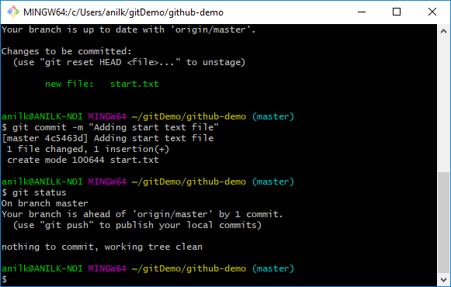
$git commit –m “message”

Slide 44
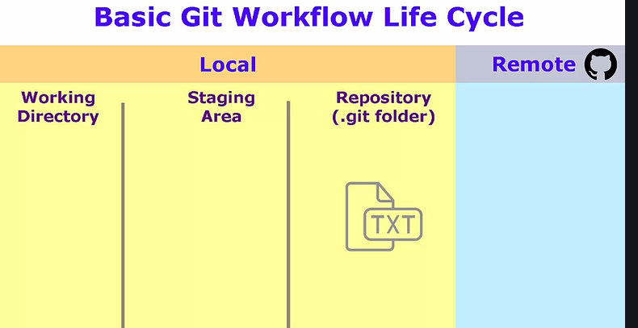
Our file moved to repository but still file is not in GitHub/GitLab

Slide 45

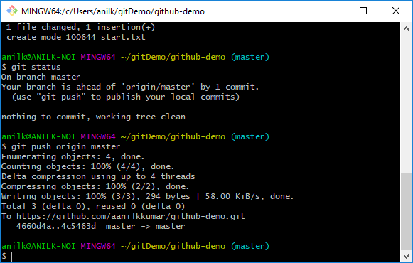
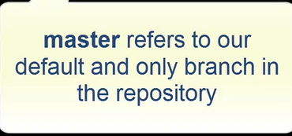
Publishing to Github.

Slide 46
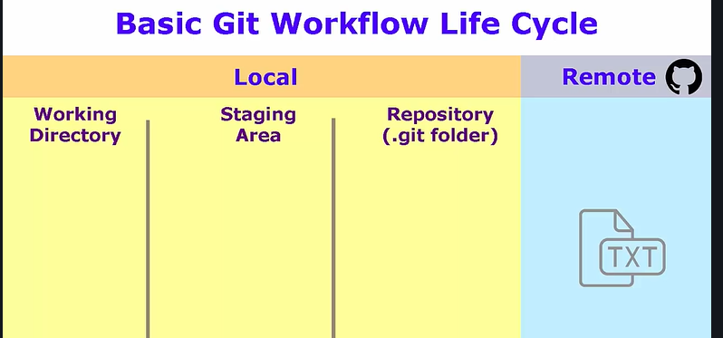
$git push

Slide 47
All in one
Working area staging area .git repo remote
git add
git commit
git push
git reset
git merge
git fetch
git pull

Slide 48
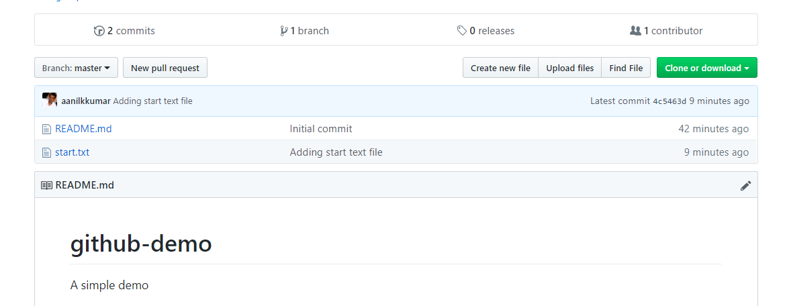
And here is our file.

Slide 49
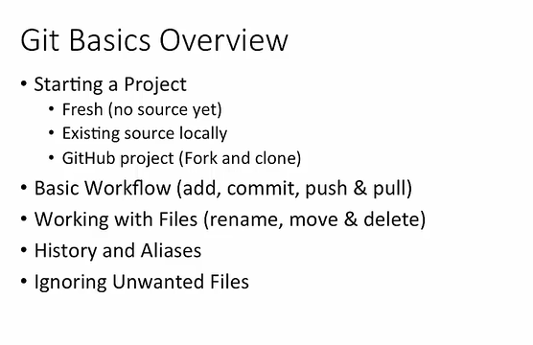

Slide 50
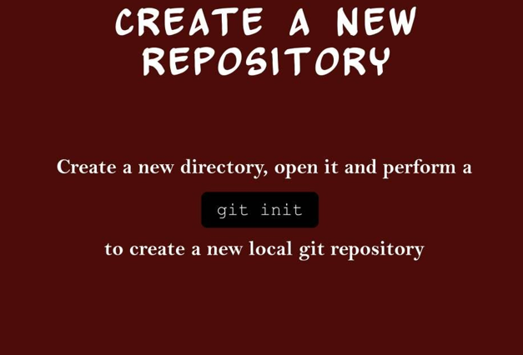
Starting a project.

Slide 51
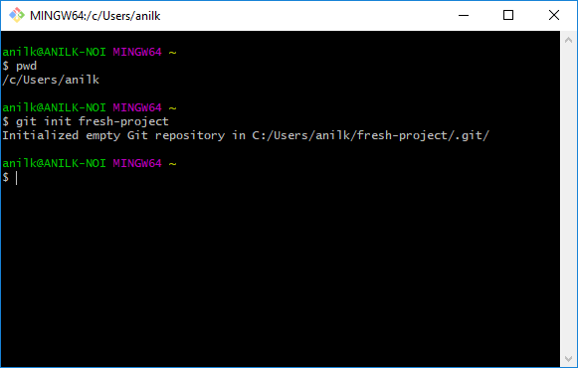
Starting with fresh project

Slide 52

.git folder created; git repository lives here.

Slide 53

Various git folder under .git

Slide 54

Status of fresh project, master branch, nothing to commit

Slide 55


Fresh Project
1. Create a text file
2. Add text here, save and exit.

Slide 56


Fresh Project
3.Status of text file, untracked file, file at working directory
4. Add to staging area

Slide 57


Fresh Project
5. Write $git commit
A text file will open; add message, save and exit
6. File is committed.

Slide 58

To delete the project

Slide 59


Git to add existing project
Navigate to intializr.com to get some source code. Click on Bootstrap
Click on download it.

Slide 60


Existing project.
1. Unzip is downloaded in download section. Now unzip it Create a project directory and navigate to it and then unzip.
2. Extracted in project directory. ls

Slide 61


Existing project.
3.Rename to the project
4. Add to git source control, navigate to web-project

Slide 62


Exiting project
5. Now we can see .git folder
6. Get the status, git will remind for untracked files. It will also that it’s an initial commit.

Slide 63


Existing Project.
7.Now add to staging area
8.Added to staging area

Slide 64

Existing project.
9. Commit the files.
One line for commit, this will not open text editor for comments. Check the status.
10. rm –rf .git, if we remove .git folder then git will no longer mange the project.

Slide 65

Starting github by joining an existing Project (git clone) https://github.com/scm-ninja/starter-web click on fork button(right corner).this will create a copy of the project to our own directory.

Slide 66


Existing Github project.
Project under my username
Clone the project to our local system
Copy the url

Slide 67


Existing Github project.
1. Clone the project
2.Check the project, navigate to the project, check the status of the project

Slide 68


How to add new files in git repository
3. Open a text file and write something, save and exit
4. hipster.txt is added

Slide 69


GitHub existing project.
5. hipster.txt is in working directory
6. git add hipster.txt
git status
Hipster.txt is in staging area

Slide 70


GitHub exiting project.
7. git commit
This will open a file to add comment as we are not passing messsage with git commit.
8. Add comment, save and exit.
File will be committed
Commit command is local operation and it does not commit to remote.

Slide 71


Existing GitHub Project.
9. Now before publishing to git it’s good to take update. So pull to get update.
Pull command pulls from git to local directory.
10.It says Everything is up to date

Slide 72

Publish to GitHub

Slide 73

What are tracked files? Ans: Tracked files are those file for which git already aware of it i.e the file is already committed to git

Slide 74


What is Tracked files?
1. Create a file.
2. Write something, save and exit.

Slide 75


What is tracked files.
3. We can see modified files
4.Add, commit and message in one line

Slide 76


Tracked files.
To get list of all tracked files we use
git ls-files
To check ls-files

Slide 77


Tracked files.
1. Create a file, add some text, save and exit.
To get it tracked add to staging area
Git add newfile.txt and then commit.

Slide 78


Recursive add
1. Directory level1/level2/level3/level5 created
2. Create a file a level1, level2 ..level5

Slide 79


Recursive files.
Files created at level1,2,3
Move starter-web directory.
git add . (to add recursively), then commit
git commit.

Slide 80


Backing out changes
1. Move to level1 folder.
2. Edit the file.

Slide 81


3. Add some other text
Check the status
4. Add file to staging area.

Slide 82


Backing out changes.
3. To move back to working directory area use reset
Check the status, again it is modified file.
4. To revert the changes that we added to file we use check out. We moved to previous version or nothing to add to staging area. If we open the file, the content also gets removed.

Slide 83


Renaming and moving files
Move to level3 directory
Git has renamed at operating system level

Slide 84


Renaming and moving files.
But not updated in git repository so commit
Always rename file before any changes so that git easily track it’s history.

Slide 85


Renaming
Renaming without using git, move to level2
Here we can see that old file is deleted and new file is created with new file name.

Slide 86


Renaming and adding.
git add –A
Will recursively add all the files which are renamed also
Commit the file

Slide 87

1.To move a file from level2 to level3 2.Commit the file

Slide 88


Deleting files
Create a file
Deleting a file which is not tracked by git
rm doomed.txt

Slide 89

Get back deleted file
Deleting a file which is tracked
git rm newfile.txt
Git commit

Slide 90


Reset it
Checkout it

Slide 91
To delete directory including files recursively
If we delete file using rm, to update git use
Git add –A
The commit
Git commit
rm –rf level1
git add –A
git commit –m “deleting all”

Slide 92

Git history git help log (to get help page)
git log
git log –abbrev-commit(with commit id)
git log –oneline –graph –decorate
We can display using commit id range
git log –since=“3 days ago”
git log --all –-graph –-decorate --oneline

Slide 93
Specific history for individual file
git log – hipster.txt
Git log –follow – level1/level3/level3.txt
Git show commit id

Slide 94
Git alias i.e alias for another git command
To create own hist command
Alias are stored in git config file
git log --all –-graph –-decorate --oneline
git config –global alias.hist “log --all –-graph –-decorate –oneline
”
Git hist (will display same output as above)
Vim ~/.gitconfig

Slide 95

Ignoring unwanted files
Git track using gitignore file
Create gitignore file
Vim .gitignore
Say for example you want ignore folder test. So write test/ in .gitignore, save and exit
git status
git commit -am "Excluding log file directory" git status

Slide 96
Clean up and back origin
Origin refers to the same of the repository
Master is the default branch
git pull origin master
git push origin master
Now github.com is updated.

Slide 97
For comparison and conflict resolution
Step 1
Step 2
P4merge
Download and copy the installation path("C:/Program Files/Perforce) and set to Path in environment variable.
Open git bash and write p4merge to check.
From git bash set global
git config --global merge.tool p4merge
git config --global mergetool.p4merge.path "C:/Program Files/Perforce/p4merge.exe“
git config --global diff.tool p4merge git config --global difftool.p4merge.path "C:/Program Files/Perforce/p4merge.exe"

Slide 98


Git repository setup for comparison
Configure p4merge
Navigate to starter-web project , cd /projects/starter-web/
Create Read.md file, add some text, save and exit. Then add to git, then commit.
Again edit the README.md and donot add to git, now check the diffference

Slide 99

Use $git difftool to see the difference in editor. (difference in working and staging area.)

Slide 100

Comparing between working directory and last commit on this branch
Comparing between working directory and last commit on this branch
Using the tool
git difftool HEAD

Slide 101

Comparing between staging area and last commit(.git repository)
If there are two file in which there is changes and we want to get the comparison for one of the file, then use
git diff – filename
e.G git diff – README.md
Git difftool – README.md

Slide 102


Comparison between Commits
Comparison between a commit id and last commit i.e Head commit
Comparison between head and head-1

Slide 103

To compare two random commit id
Differences between two branches
Local master branch and remote master branch
git diff master origin/master
git diff commit1 commit2
git difftool commitid1 commitid2

Slide 104


Branches

Slide 105


Git branch –a
Will display both local and remote branch
* Asterrisk show active branch
To create a new branch

Slide 106


To switch branch we use checkout.
Check * asterisk is moved to mynewbranch
Branches are like label

Slide 107

To rename a branch
Git branch –m mynewbranch newbranch
To create a branch in a single line
To delete a branch
Git branch –d newbranch

Slide 108
To merge a file from a branch to master or another branch
Automatic merge
Switch to master branch
Review changes using diff
e.G git diff master title-change
3. Git merge title-change
Create a new branch, under that create a file
Switch to master branch and edit any file and add,commit it.
Git merge branch_name –m “message”

Slide 109

Merging conflict
Create a new branch
Edit same file in master and newbranch
Git difftool 1st_branch 2nd_branch
Move to master branch
Git merge 2nd_branch
^{This will show conflict}
Open the file in which changes were done, we will see that content of both file is in that 1st file
git mergetool -> this will show content in merge tool
^{Resolve the conflict}
^{Commit the file}

Slide 110
Rebase command says that it's rewinding our head, which is our current branch, so that we can re-apply any changes that we've made, on top of whatever's happened on master
Rebase example
Create a feature branch of a master branch, do some work there
Switch to master branch, do some work there
Rebase the master branch changes to feature branch
git checkout –b myfeature
Edit any text file, save and close
Check the status git status
Add and commit to feature branch
Switch to master git checkout master
Edit README.md save and close, commit the file
then rebase my changes back into the feature branch, Return to feature branch git checkout myfeature
git rebase master (source branch)
Check log
git log --oneline –decorate –all --graph
git rebase –abort (to abort rebase)

Slide 111
"git fetch" is a non-destructive command that simply updates the references between the remote repository and the local repository.
git fetch origin master
git pull –rebase origin master

Slide 112
Ex.
1. Create submodule (git clone url)
2. Create another submodule( git clone url)
Create main module and clone
Navigate to main module( cd )
Git submodule add url of submodule.
Similarly for another module.
Add, commit, push.
To fetch (git clone - - recurse-submodules url of main module)

Slide 113
Case 1 if we are changing in submodule (ex. App) then,
1.add, commit, push for submodule
2. Cd .. (navigate to main module)
3. Git
To Take update from main module.
git submodule update --remote

Slide 114

Thank You.

